Slide 1

Personalizing Learning
Richard Culatta, Deputy Director
Office of Educational Technology | US Department of Education
www.ED.gov/technology
@OfficeOfEdTech

Slide 2
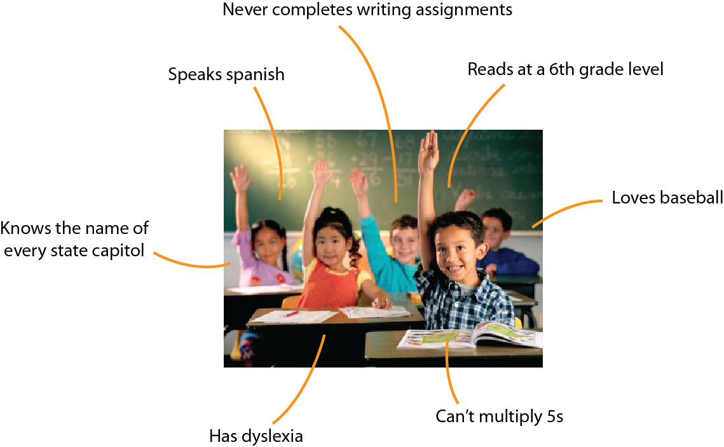
The traditional teaching model treats all learners the same despite unique needs and strengths

Slide 3
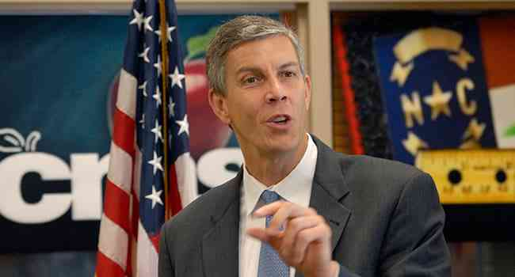
It’s Time for a New Model
“We must take classroom learning beyond a one-size-fits-all mentality and bring it fully into the 21st century”

Slide 4
Technology can help…
Notes:
By using technology effectively, we can personalize learning in a way that addresses these challenges

Slide 5
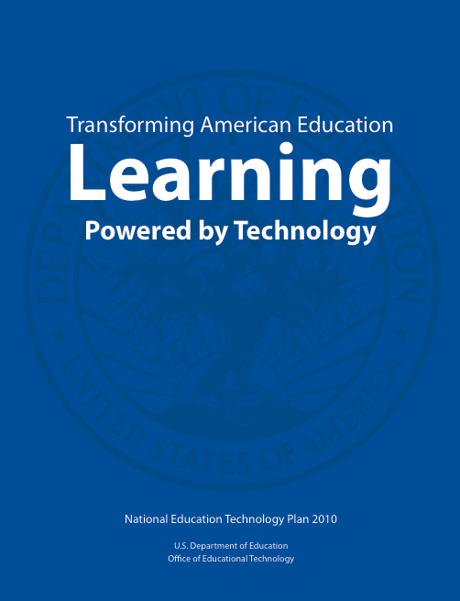
National Ed Tech Plan
“Technology gives students opportunities for taking ownership of their learning. Personalized learning is paced to student needs, tailored to learning preferences, and customized to the specific interests of different learners.”

Slide 6
What is Personalized Learning?
Adjusting the pace (individualized)
Adjusting the learning approach (differentiated)
Leveraging student interests/experiences
= Personalized Learning

Slide 7
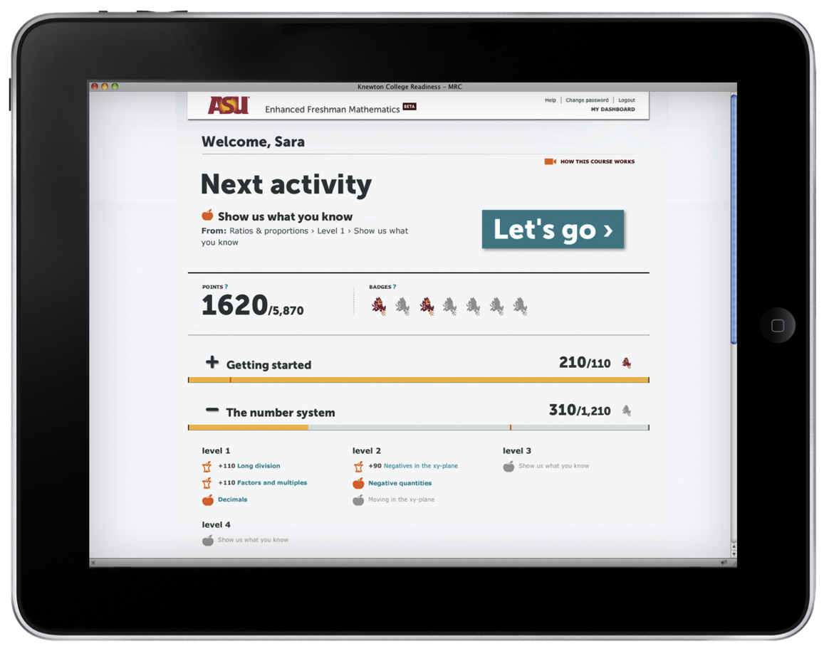
Examples of Personalized Learning
Systems that adapts to learner needs
Notes:
Individualized/Adaptive (adjusts content around a specific topic)

Slide 8
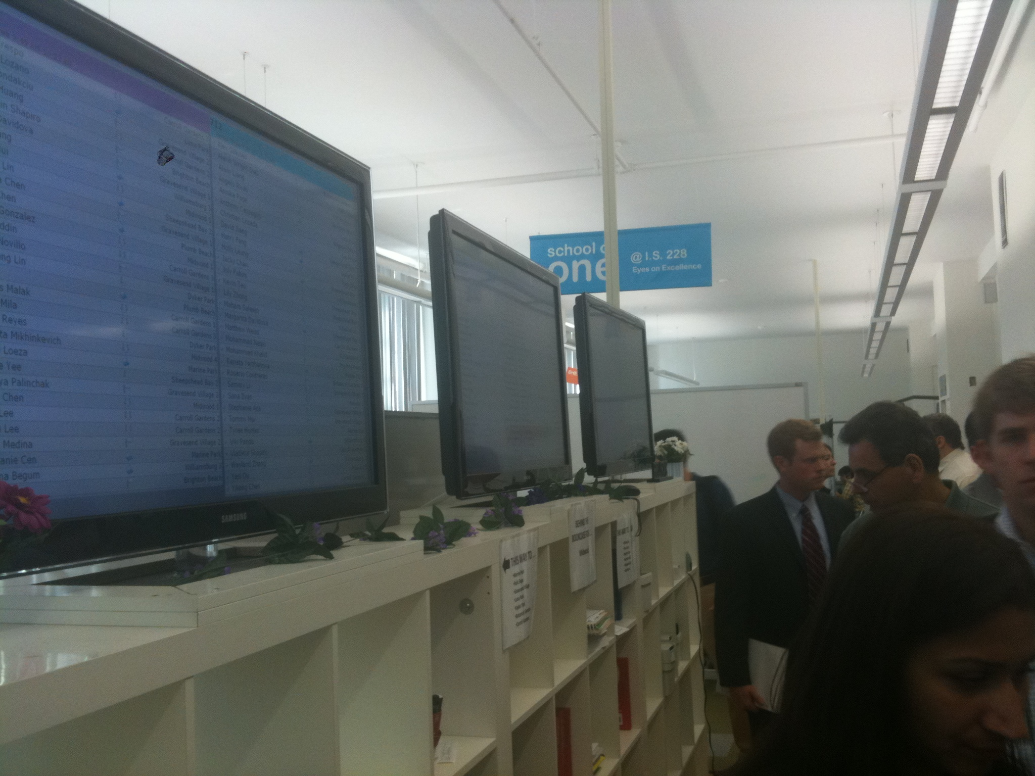
Examples of Personalized Learning
Systems that support differentiated learning
Notes:
Differentiated (algorithm tries different approaches to instruction)

Slide 9
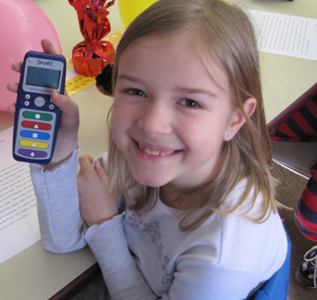
Examples of Personalized Learning
Increasing the frequency of formative assessments
Notes:
Garland HS in TX. Formative assessments: increased formative assessment by 10x (lots of medium quality questions). Instructor reviewed results and made decisions about what to do next. Had 15% drop out 1/3rd didn’t show up regularly – went to 100%attendance and no dropouts. Freed him up to “coach” the kids (not always academic issues causing the problem)

Slide 10
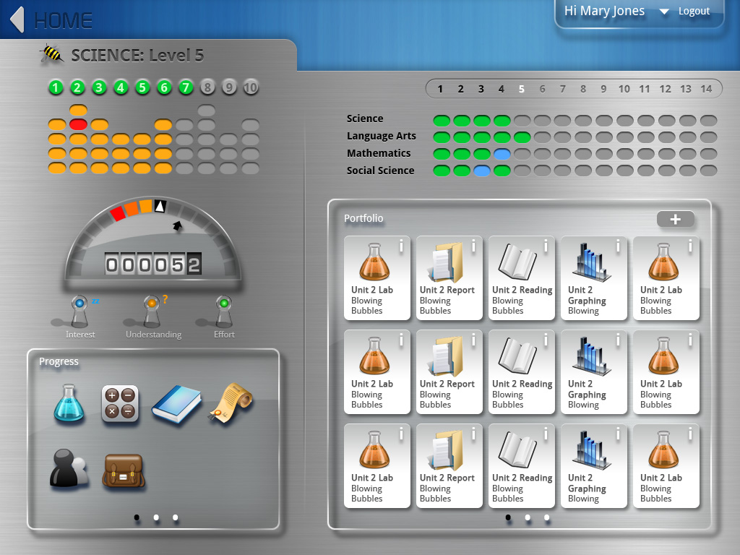
Examples of Personalized Learning
Providing learners choice about what and how they learn
Notes:
Tools that help students understand where they’re at and make choices about what to do next

Slide 11
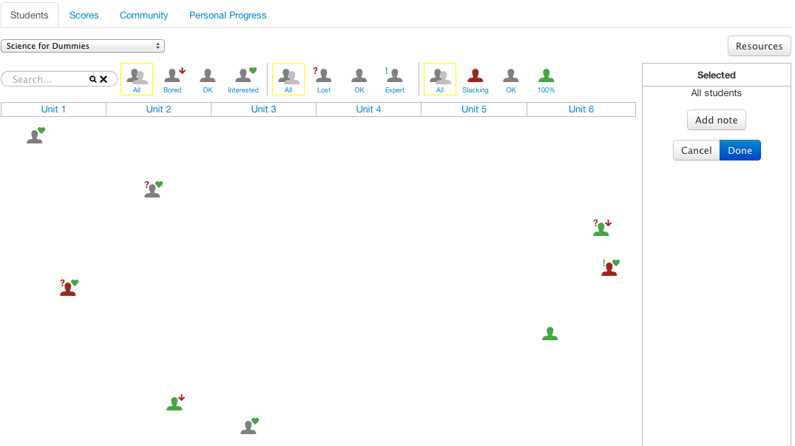
Examples of Personalized Learning
Customizing instruction based on performance/preference

Slide 12
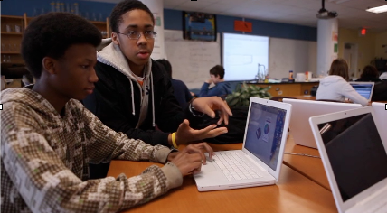
Examples of Personalized Learning
Approaches that turn learners into creators
Notes:
Teachers don’t have to assign the same thing to everyone. Mooresville example of Brown vs. BOE

Slide 13
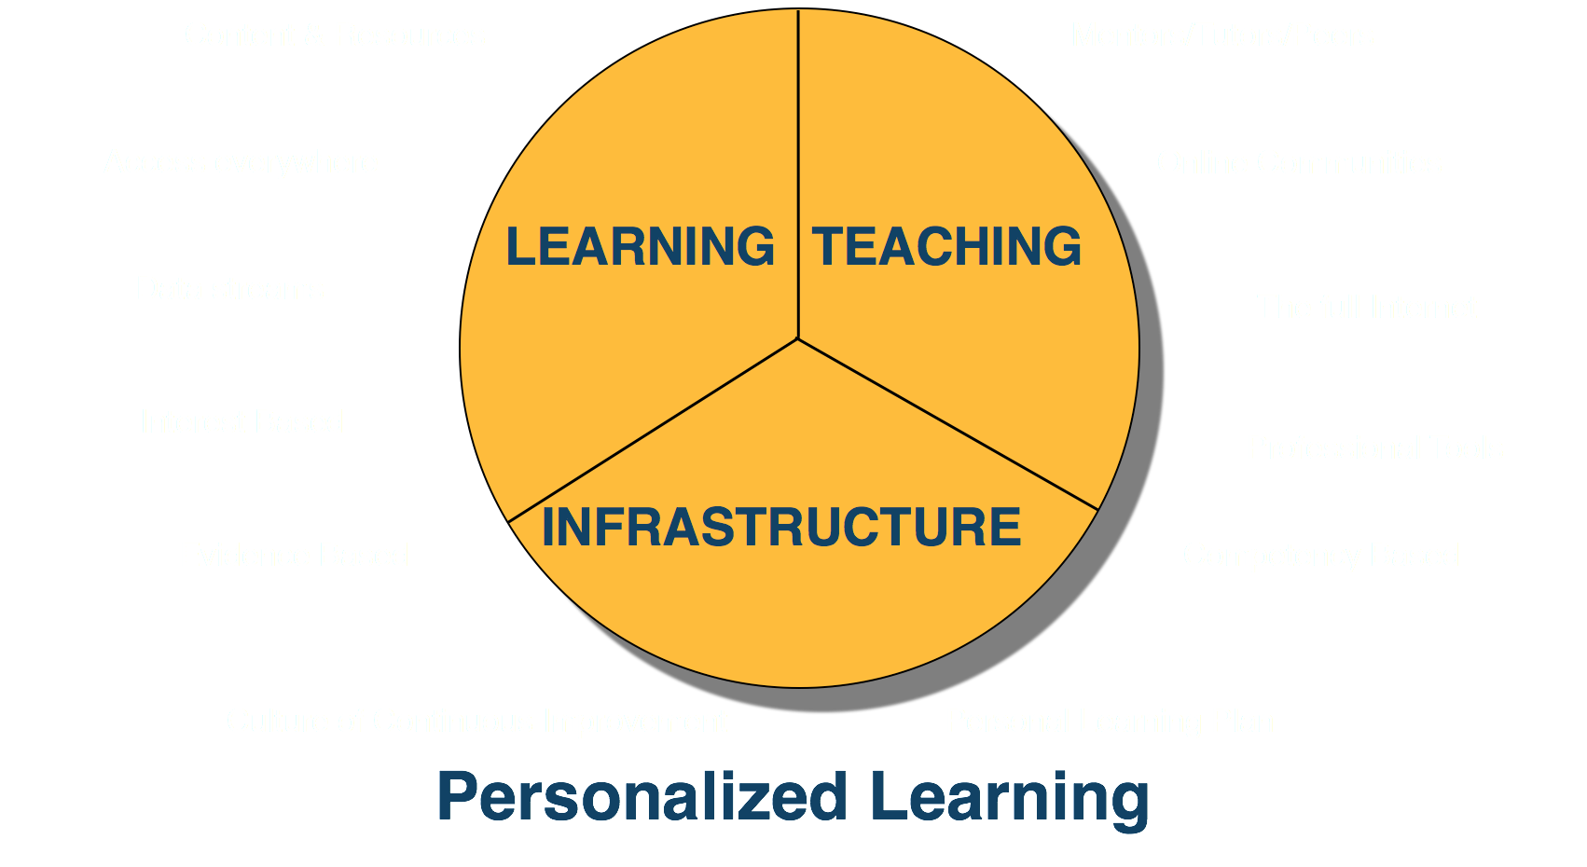
Essential Elements of Personalized Learning

Slide 14


Essential elements
Students need their own devices/access
Computer
Lab

Slide 15
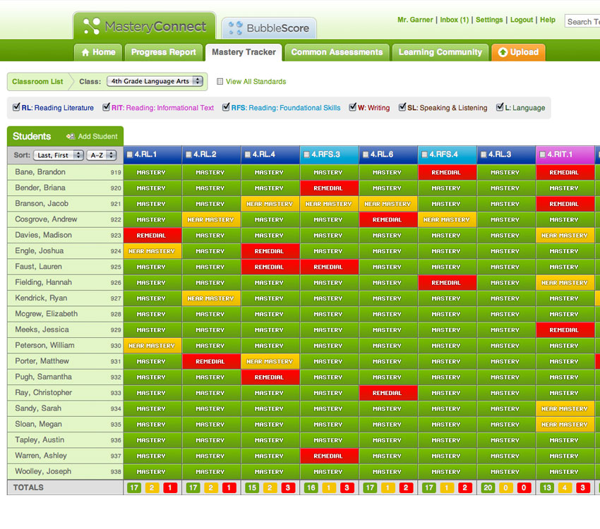
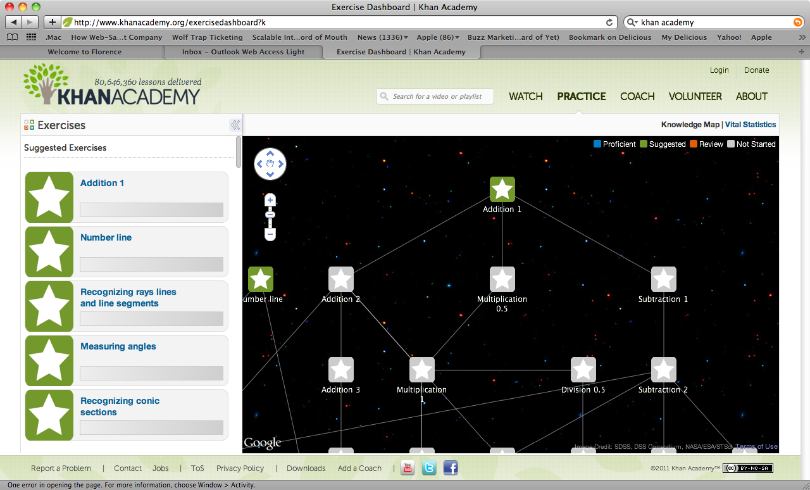
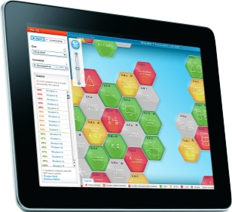
Essential elements
Near-real-time feedback to parents/students/teachers:
You Are Here

Slide 16
Essential elements

Slide 17

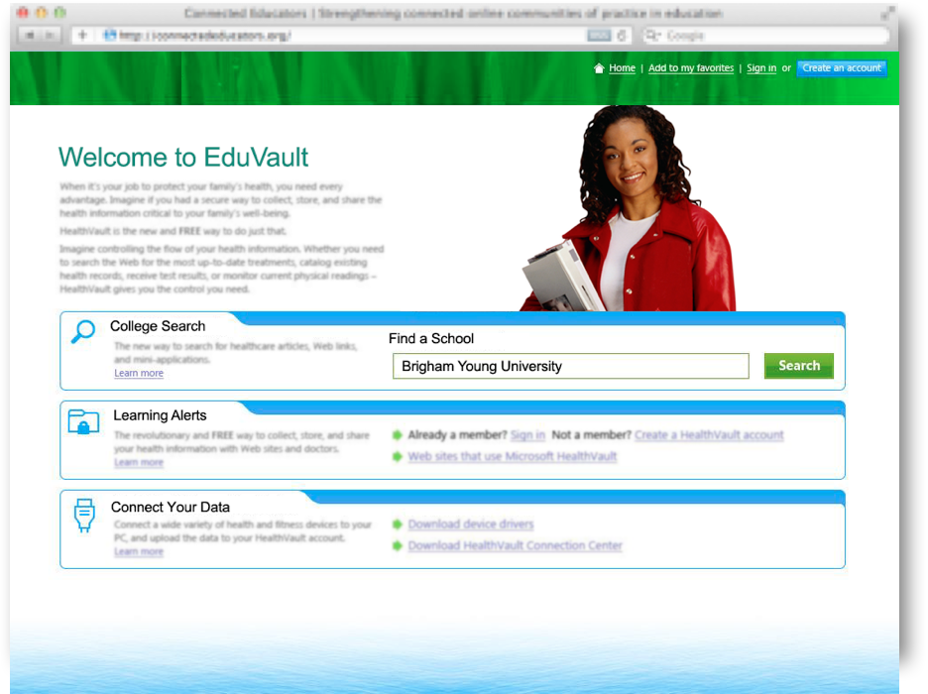
Essential elements
Ability for students to own their data
Student-managed electronic learning portfolios can be part of a persistent learning record and help students develop the self-awareness required to set their own learning goals; express their own views of their strengths, weaknesses, and achievements; and take responsibility for them.
- National Educational Technology Plan

Slide 18
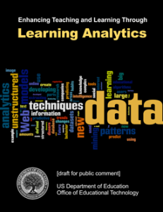
Essential elements
Leveraging patterns from digital interactions to improve improve instruction, and fuel research:

Slide 19
Personalized learning is for teachers too!
Notes:
Drive-by professional development is not effective

Slide 20
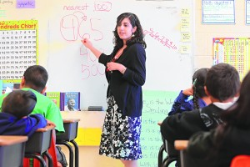
Personalizing Teacher Improvement
Notes:
Example of TFA approach: teacher with earpiece received real-time feedback from a coach to improve teaching

Slide 21
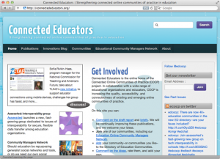
Race to the Top - District
Education

Slide 22

What can you do?

Slide 23

Final Thoughts

Slide 24
Thanks!
www.ED.gov/technology
@OfficeOfEdTech

